Slide 1
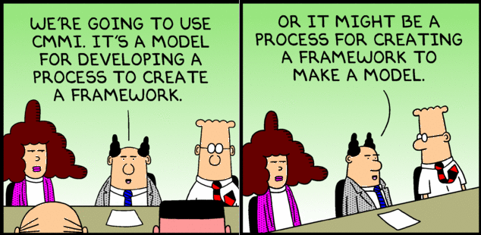
System Diagrams
A Visual representation of the system

Slide 2
Model
  Architecture – abstraction
    highlight important
    hide details
    e.g., subway map
      does not show building & streets
      distorts geography / positioning/ distance
      only stations & lines => easy to understand important things
        main goal – navigation
          how to get from A to B
  Expressed by a model
  Model - description without details
    systematically removed on purpose
    intentional simplification
https://www.cl.cam.ac.uk/teaching/1112/SWDesign/softwaredesign01.pdf

Slide 3
Model
  Most important engineering tool
    cannot consume every detail (7+-2)
      => multiple levels of abstractions
    allows to understand & analyze large & complex problems
    allows to communicate the architecture
    allows to share knowledge
    allows to investigate incidents without reading the code base
https://www.cl.cam.ac.uk/teaching/1112/SWDesign/softwaredesign01.pdf

Slide 4
Model
  Model can be:
    picture
      visual perception times faster than text (60k times + better retention)
    visual flow (sequence, flowchart, relationship)
      cannot express time in other way => static pictures
    approximating formula for a metric of the system
      dependency between smt & performance / complexity / usability
      e.g., track every car VS traffic flow equation
      e.g., Big O – no need for algo details (need nlogn)
    Can describe different views of the system
https://www.cl.cam.ac.uk/teaching/1112/SWDesign/softwaredesign01.pdf

Slide 5
Views and Models
Complex systems – cannot be understood via 1 perspective
  different stakeholders – different perspectives
  e.g., airport
    security – passenger flow & checkpoints
    “baggage department” – baggage flow
    air control – air traffic
    maintenance – energy consumption
    etc
    cannot put into 1 model
  RIT – students vs professors
  Model – abstraction / blueprint of a system
    e.g., patients, doctors, nurses, appointment system - what & connections
  View – representation of a model from some perspective
    e.g., how a patient books an appointment

Slide 6
Views and Models
User Model
How a user interacts with the software
  Flowcharts; process maps; …
  e.g., ATM money withdrawal
    insert card
    enter PIN
    request amount
    dispense cache
    receipt
    what’s missing?
      returning the card
    incorrect models => dysfunctional systems

Slide 7
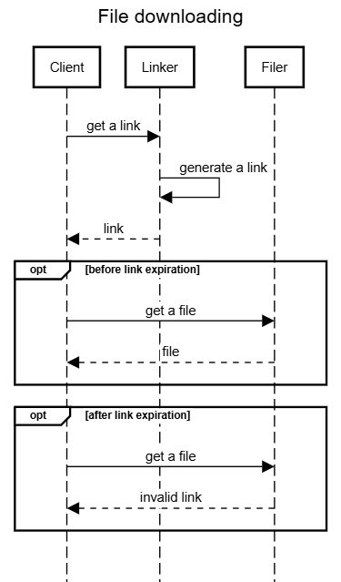
Views and Models
Interface view
How different APIs are used
  Sequence diagrams
  e.g., file downloading
    call link generating endpoint
    receive a time-limited link
    use the link to obtain a file
  how to integrate

Slide 8
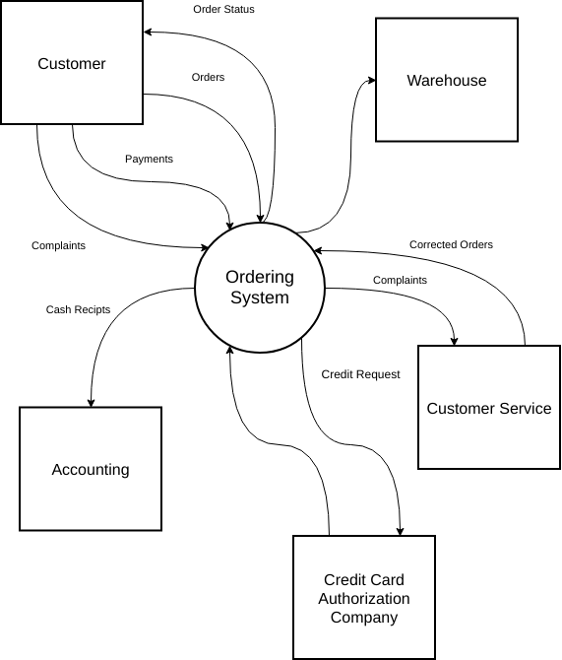
Views and Models
System View
How components interact with each other
  Main components; connections; operations; …
  Component diagrams, architecture diagrams,..
  e.g., online banking system
    web portal / mobile app
    backend server
    database
    credit bureau
    etc
    btw, image is unrelated & far from perfection
  map of a city

Slide 9
Views and Models
Performance Model
Calculate the performance of an operation within certain scenarios
  Spreadsheets; formulas;..
  e.g., percentage of 504 (time out) customers get when N requests
  e.g., what hardware is needed for N parallel customers
  e.g., how many parallel request can withhold
  e.g., algorithm complexity is different – consequences?
  very system specific
Netflix
  user model – browsing & playing movies
  interface view – API call between FE & BE
  system view – microservices & CDN
  performance model – streaming quality when 1M viewers

Slide 10
Types of Views
  System Diagram – Abstract description of the system whose requirements are being modeled
    what is there & how connected
    high-level – major subsystems
    communicate to stakeholders
  Module View – Structure of the code base
    packages, classes, layers, modules
    used by devs & for onboarding
  Component and Connector Views – What exists & connected in runtime
    e.g., REST calls, event buses, data streams
    NOT sequence of events
    runtime as a static picture
  Allocation Views – Software to environment mapping
    e.g., microservice -> docker -> k8s -> set of nodes -> AWS
    e.g., endpoint handler -> Lambda function -> AWS
    e.g., mobile app -> phone / smart tv / browser

Slide 11
Types of Views
  Quality Views – Extracted relevant pieces of structural views and packaging them together
    e.g., security view – how auth handled & how data is protected
    e.g., performance view – data flows, caching, bottlenecks
    e.g., availability view – redundancy, failover, clusters
  Behavior Views – Interactions between components when the system is a specific state
    sequence of events for a specific case
    sequence diagrams
  Can create custom views
    depends on a system / people / situation / needs
    e.g., asked for a PII data flow specifically

Slide 12
Which Views? The Ones You Need!
You don’t need every possible / listed view
  Tool
    use to solve problems & communicate
    not because “it must be done”
      e.g., plumbing diagram for a tree house
  Different views support different goals and uses
  depends on stakeholders / needs / documentation use
    onboarding -> module view
    devops -> allocation view
    executives -> system view
  Trade-off
    Benefit – clear communications, less errors, better analysis
    Cost – efforts & time to create & maintain
      often not having > outdated
At least component and connector view

Slide 13
System Diagram
  Abstract Description of the system
  High-level abstraction / model
Components of a System Diagram:
  Boundaries of the system
    what is within & outside
    e.g., credit bureau is outside (still be shown)
    avoid scope creep
  Inputs to and outputs from the system
    Inputs – requests, user actions, data streams, etc
      e.g., PIN entry, withdrawal request
    Outputs – produced value / results
      e.g., cash, receipt, account balance information

Slide 14
System Diagram
  Abstract Description of the system
  High-level abstraction / model
Components of a System Diagram:
  Subsystems of the system
    major parts
    e.g., video processing, ordering, payment
  Interfaces between the subsystems
    how subsystems communicate
      e.g., ordering interacts with payment, triggers shipping
  Describes high-level design decisions

Slide 15
Why Create a System Diagram?
  Stakeholders – engineers, managers, QA, customer, etc
    very different
      background
      interests
      vocabularies
    SD - simple visual language, simple entities
  SD use cases:
    Explain requirements (ties to the arch) to stakeholders
      e.g., “support 3rd-party payment providers”
        diagram: mobile app -> payment gateway -> bank APIs

Slide 16
Why Create a System Diagram?
  SD use cases:
    Design discussion among engineers
      2 competing complex solutions
      hard to explain
      easy to perceive visually
      avoid misunderstandings
    Document the system for implementation
      guidelines / reference / documentation
      how the system should be implemented
    Show the architecture in any other case
      e.g., investor want to understand / audit
  Need to maintain!

Slide 17
Type of System Diagrams
System Diagrams are variable in their view of the system
A system diagram can show / emphasize
- Components
  subsystems & how grouped
  Q: what are the main parts?
  e.g., map subsystems on departments
- Interactions
  connections among subsystems
  Q: how do parts communicate?
- Boundaries
- …
What question do you answer?
Defines included information
  Big blocks
    Very high level for C-management
  APIs
    Integration points for devs
  Physical assets
  Data or communications
    Information flow
  …
Then select HOW you will show it
Components & Interactions tend to be the most common

Slide 18
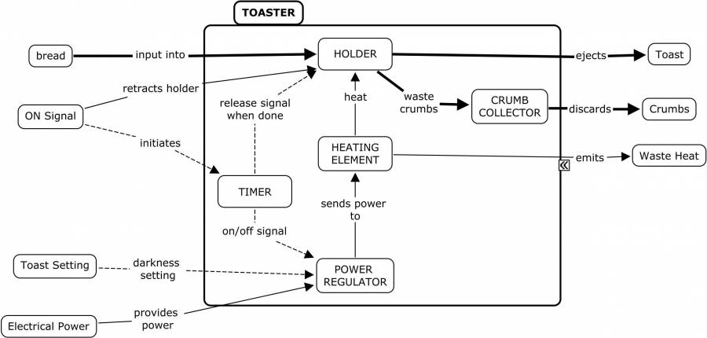
Toaster System Diagram:
Inputs
Outputs
System
Where’s the WIFI connection?
https://deseng.ryerson.ca/dokuwiki/_detail/design:toasterarchitecture.jpg?id=design%3Asystem_diagram

Slide 19
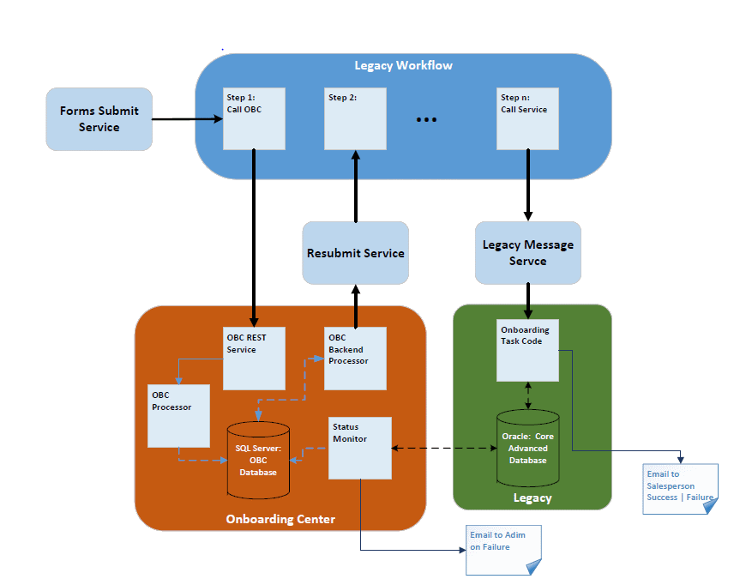
Onboarding System
Notes:
Early prototype of the system built to illustrate that a new service could be interposed in the legacy workflow and enrich the content flowing into the Legacy System (Green box).

Slide 20
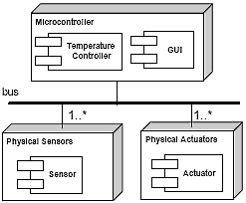
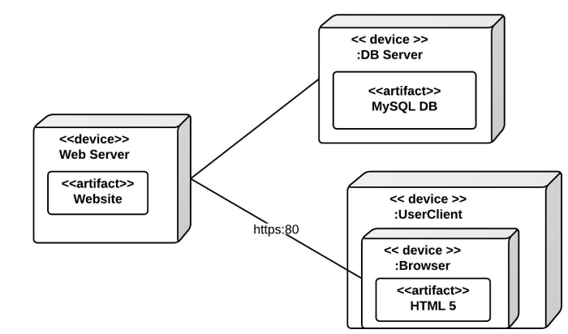
Allocation View Example

Slide 21
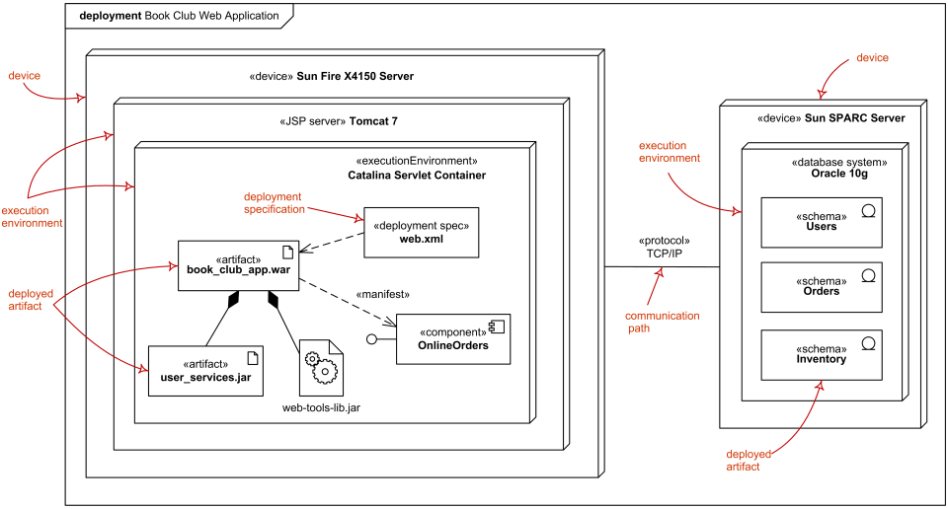
Allocation View
UML Deployment Diagram Example

Slide 22
Usage of Allocation Views
Without:
  what software exists
  not where it runs
  not how it is delivered
Helps to understand
  what hardware and software is needed
    servers, cloud instances
  where should be placed
    cloud vs on-premise
    ML model – local (latency) vs cloud GPU (performance) vs availability (nowhere to place)
  distribute maintenance across teams
    defined responsibility
  how to setup CI/CD
    builds, integration testing, version control, etc
    local service vs k8s in cloud – different processes

Slide 23
Usage of Allocation Views
Elements
  Software element
    logical modules – processes, services, packages
  Environmental element
    execution - hardware, runtime operation
    development - file structure, deployment, development organization
    properties of an env
      e.g., network bandwidth, CPU performance, etc
        bandwidth defines video streaming quality
Relations
  Software element (logical) is mapped (allocated to) an environmental element (physical)
  Static or dynamic
    Static – always the same env element
    Dynamic – vary (e.g., autoscaling – new containers / nodes)

Slide 24
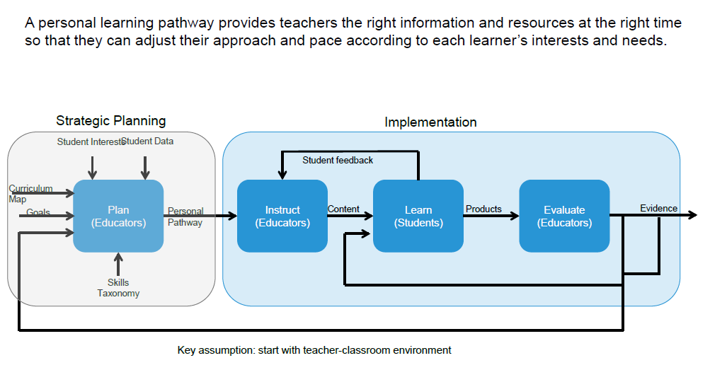
Personal Learning Pathways: Systems View
Notes:
A system designed at PARC for Personalized Learning. Used to discuss the system with school administrators, teachers and parents

Slide 25
Unit of study as a context for prototyping
Student Performance
Learn
(Students)
Feedback for instruction & planning
Student Profile
Instruct
(Teacher)
Practice
Plan
(Teacher)
Paths
Evaluate
(Teacher)
Evidence
Demo
Content, Curriculum map
Student Profile
Alerts
Goals and Interests
SIS
Unpack concepts
Sequence
Scaffold
Model
Assign
Score
Monitor
Adjust
Communicate
Collaborate
Teach interventions
Mastery
Growth
Portfolio
  Exemplar
  Parent/teacher
  APPR
  Issue tracking
Practice (assignments, check-ins, formative assess)
Demonstrate (summative, benchmark)
Collaborate (teachers, peers)
Reflect on student performance
Student Performance
Pre-assessment
ELA summary
Writing samples
Paths
Mastery visualization
Student grouping
Key messages
Providing teachers a dynamic, holistic view of each student facilitates personalization day-to-day.
Easy and timely access to the desired information is a key challenge.
Understanding what teachers do with this information guides future development.
25
Notes:
A more detailed view that layers in where various functionality exists in the system. The circled items are were the development team was initially focused.

Slide 26
Metrics & Performance: Allocation to the system
Database usage:
Average query: 2Kbytes
  Queries/ Day: 20,000
  Transactional load: Queries/ Day x Query size = 40 MB / day
Retail
  Size of item: 1k
  # of items: 5000
  Size of DB Storage: 5000 x 1,000 = 5MB
  What if will grow to 5,000,000 items?
Performance:
  Image recognition system
    10 seconds per operation
    10,000 request per minute
    100,000 seconds CPU time required per minute**
Helps to understand
required HW characteristics
to handle the workload
What’s the catch?
** Will that work?
Notes:
It’s average, what about peak load?

